Slide 1
pNovo+ De Novo Peptide Sequencing
Batch – A
Group-09

Slide 2




SANGAM GANESH BABU
CHALLA YOGANANDHA REDDY
[CB.EN.U4AIE21056]
[CB.EN.U4AIE21008]
RANGISETTI SAI RAGHAVENDRA
Gajula Sri Vatsanka
[CB.EN.U4AIE21049]
[CB.EN.U4AIE21010]

Slide 3
CONTENTS OF THIS TEMPLATE
Introduction | pNovo+ is a computational tool that utilizes complementary HCD and ETD tandem mass spectra for accurate de novo peptide sequencing.
De Novo Peptide Sequencing | De novo peptide sequencing involves determining the amino acid sequence of a peptide without relying on a reference protein sequence.
pNovo+ Algorithm | The pNovo+ algorithm utilizes complementary HCD and ETD tandem mass spectra for accurate de novo peptide sequencing.
HCD and ETD Tandem Mass Spectra | HCD and ETD tandem mass spectra provide complementary information for peptide sequencing.
pNovo+ Features | pNovo+ offers advanced features for accurate de novo peptide sequencing using complementary HCD and ETD tandem mass spectra.
Conclusion | pNovo+ is a powerful algorithm that utilizes complementary HCD and ETD tandem mass spectra for de novo peptide sequencing, providing accurate results and advanced features for comprehensive analysis.

Slide 4
TABLE OF CONTENTS
01
02
03
04
OBJECTIVES
ELUCIDATE
Clear View about what is De Novo Peptide Sequencing
Explaining the methodology with Algorithm pDAG.
RESULTS ANALYSIS
METHODS

Slide 5
INTRODUCTION
pNovo+ is an innovative approach for de novo peptide sequencing, leveraging the complementary information provided by HCD and ETD tandem mass spectra. By combining these two techniques, pNovo+ offers a robust and accurate solution for deciphering the amino acid sequence of peptides, without the need for reference protein sequences. This advanced algorithm revolutionizes peptide analysis, enabling researchers to gain deeper insights into complex biological systems and uncover novel peptide sequences with high confidence.

Slide 6
pNovo+ is a software tool that utilizes complementary HCD and ETD tandem mass spectra to perform de novo peptide sequencing with high accuracy and efficiency. By combining these two techniques, pNovo+ is able to overcome the limitations of each method and provide a more comprehensive analysis of complex peptide mixtures.
In simpler terms, pNovo+ showed better accuracy in identifying peptide sequences when utilizing both HCD and ETD spectra together compared to using either of them individually. and its unique features that make it stand out from other peptide sequencing tools.

Slide 7

De Novo Peptide Sequencing
In traditional peptide sequencing, researchers need a known reference genome or proteome to compare their experimental data with. However, de novo peptide sequencing is different because it starts from the beginning and tries to figure out the peptide sequence only from the mass spectrometry data.
This method is helpful when trying to find peptides from organisms that don't have well-known genetic information or when looking for new changes in proteins that haven't been documented before. However, de novo sequencing can be difficult because the data is complicated, and it's easy to make mistakes when trying to understand the patterns in the spectra.

Slide 8
Database search and de novo sequencing are parallel methods used for peptide identification from tandem mass spectra. In database search, which has improved considerably in the past decades,all candidate peptides from a specified database are retrieved for each spectrum, and each peptide-spectrum match is scored via a scoring function.
There are many database search engines, such as Mascot,(2) SEQUEST,
(3) X! Tandem, (4) OMSSA,(5) ByOnic, (6) pFind, (7) InsPecT, (8) and Phenyx. (9)
They are widely used for routine analysis of tandem mass spectrometry (MS/MS) data. However, this approach fails when correct peptides are not present in the database. In situations like this, de novo sequencing is an indispensable and most valuable tool that can lead to correct peptide identification.

Slide 9

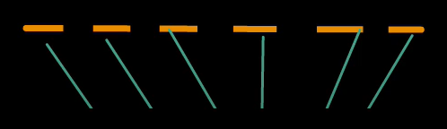
Principle in Tandem Mass Spectrum
Mass Spectrometer
Protein/peptide
The peptide is fragmented along the peptide backbone and the resulting fragment ions are measured to produce the ms spectrum the analytical technique measures the mass to charge ratio of charged particles that is the peptide fragments depending on the fragmentation method used different fragment ion types can be produced the most widely used fragmentation methods are
Higher energy collisional dissociation{HCD}
Electron transfer dissociation{EID}
Mass Spectrometer
+
Mass/charge

Slide 10
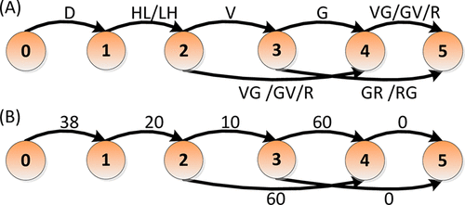
Example of Generating Graph Edges
Example of an initial spectrum graph constructed by pNovo+.
DAG translated from the spectrum graph above. The number written beside each edge is the weight of the edge. The masses of the six vertices are 0.000, 115.022, 365.168, 464.237, 521.259, and 677.359 Da. The longest, best-scoring paths DHLVGR and DLHVGR from D(HL/LH)VGR have the same score, so they are randomly assigned to be the top1 and top2 ranked sequences from this graph.

Slide 11
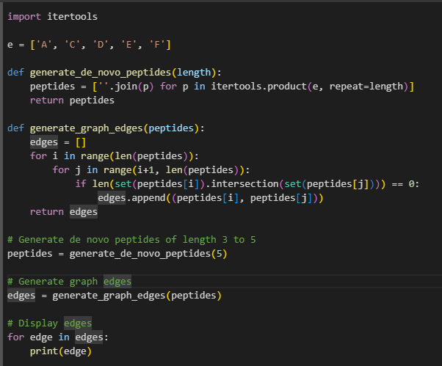
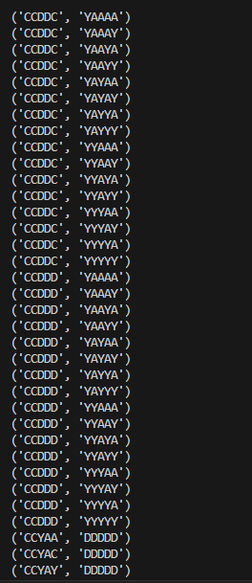
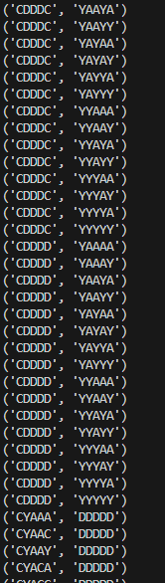
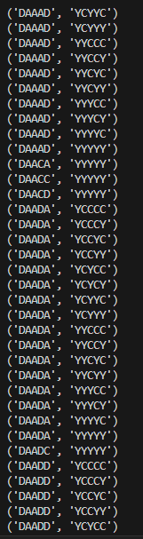

Slide 12
METHODS
Selecting Peaks
Ion Types in HCD and ETD Spectra
Constructing a DAG for Each Spectrum or Spectral Pair
Generating Graph Vertices
Generating Graph Edges
Removing the Antisymmetry Restriction
Finding the k Longest Paths

Slide 13
SELECTING PEAKS
Peak selection is one of the most important steps in de novo peptide sequencing, and many MS/MS preprocessing methods are devoted to it.
In our algorithm, we address several critical problems that can affect correct detection of signal peaks as opposed to noise peaks.
In our algorithm, we address several critical problems that can affect correct detection of signal peaks as opposed to noise peaks.
These algorithm mainly follows following Steps such as
Weighting of Peaks
Selection of Monoisotopic Peaks
Lowest Mass-to-Charge Ratio
Inclusion of Intense Peaks
Charge State Transformation
Merging Peaks
Removal of Precursor Ion Peaks

Slide 14
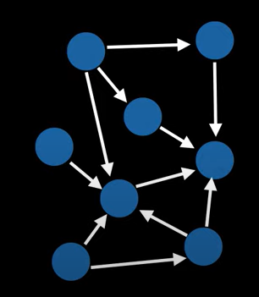
pNovo+ Algorithm
Shortest/Longest path on a Directed Acyclic Graph (DAG) | Graph Theory
Peptide Directed Acyclic Graphs are an important concept in graph theory that have numerous applications in various fields of science. By representing the structure of peptides using DAGs, researchers can gain insights into the structure and function, which play a crucial role in many biological processes. The ability to find the shortest and longest paths on a peptide DAG is particularly useful in bioinformatics and drug discovery, where it can help identify the most stable and in flexible regions, as well as potential drug targets.
By analyzing the structure of proteins using peptide DAGs, researchers can identify potential drug targets and design drugs that can bind with high affinity and specificity.
Recall that a Directed Acyclic Graph (DAG) is a graph with directed edges and no cycles. By definition this means all trees are automatically DAGS since they do not contain cycles.

Slide 15
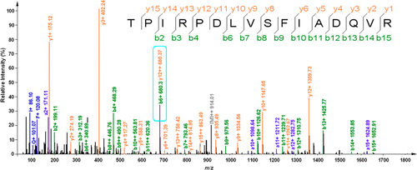
Removing the Antisymmetry Restriction
The antisymmetry restriction is often imposed to facilitate peptide synthesis and improve the chances of successful folding and stability of the designed peptide. By enforcing a symmetric sequence, the resulting peptide is expected to adopt a well-defined secondary structure, such as an alpha helix or beta sheet, which can enhance its stability.
These algorithm mainly follows as
The, removing the antisymmetry restriction in de novo peptide design allows for the exploration of novel peptide sequences with diverse properties and functions. However, it also introduces additional challenges in terms of synthesis and structural characterization. Researchers would need to adapt their computational design approaches and consider the implications of asymmetry on peptide synthesis and stability.

Slide 16
k Longest Paths
In pNovo+, a popular de novo peptide sequencing software, the primary objective is to determine the most likely peptide sequence from tandem mass spectrometry (MS/MS) data. While pNovo+ focuses on identifying the top-ranked peptide sequence, it does not directly provide functionality to find the k longest paths.
The concept of finding the k longest paths typically arises in graph theory, where a graph represents a set of vertices connected by edges. However, de novo peptide sequencing in pNovo+ is not based on a graph representation.
Consequently, finding the k longest paths in de novo peptide sequencing requires sophisticated algorithms and may involve trade-offs between accuracy and computational efficiency.

Slide 17
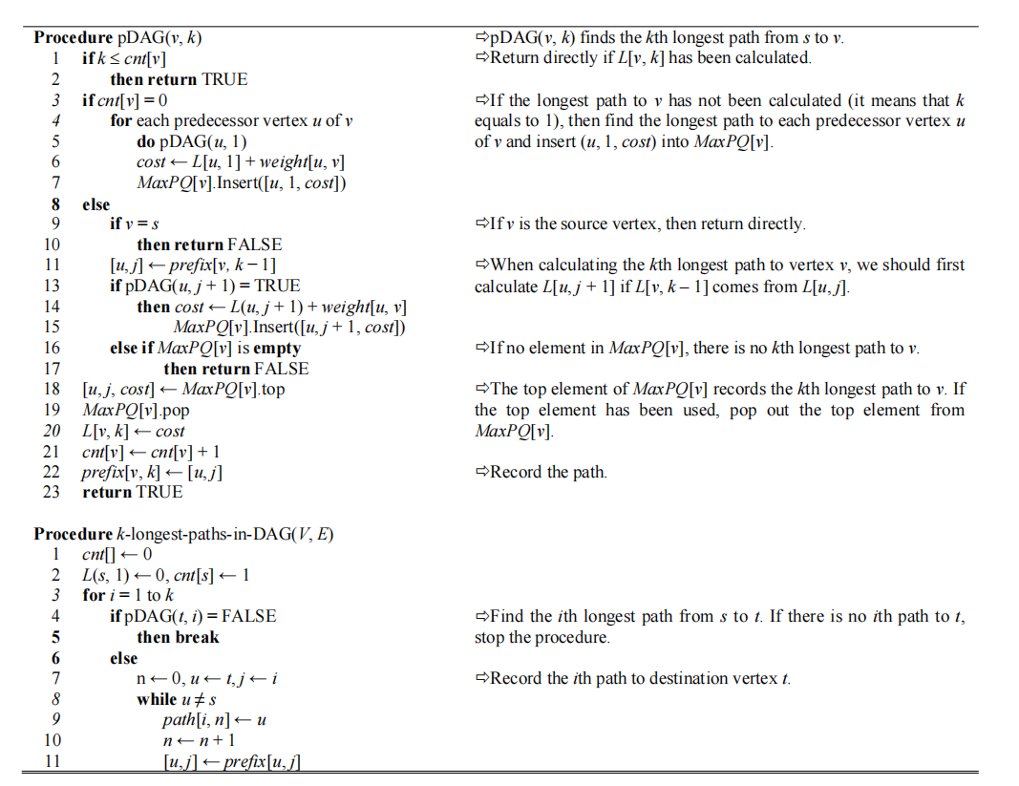
Finding the k Longest Paths
Input
DAG(V, E), V is the set of vertices, and E is the set of edges. u, v ∈ V, edge(u, v) ∈ E. s is the only source vertex, and t is the only destination vertex. weight(u, v) is the weight of edge(u, v).
Output
path is a two-dimensional array. path[i, j] is the jth vertex on the ith longest path from s to t.

Slide 18
Overview
Procedure pDAG(v, k) is a function to find the kth longest path from s to v.
Procedure k-longest-paths-in-DAG(V, E) is a function to find the k longest paths and record them in path.
L[v, k] records the weight of the kth longest path from s to v.
MaxPQ[v] is a maximum priority queue, each element is a three-tuple (u, j, cost) which records one path from u to v. u is the predecessor vertex of v on the path and cost is the sum of L(u, j) and weight(u, v)
cnt[v] records the number of paths from s to v which have been calculated
prefix is a two-dimensional array. If prefix[v, k] is (u, j), it means that the kth longest path from s to v consists of two parts, the jth longest path from s to u and edge(u, v).

Slide 19
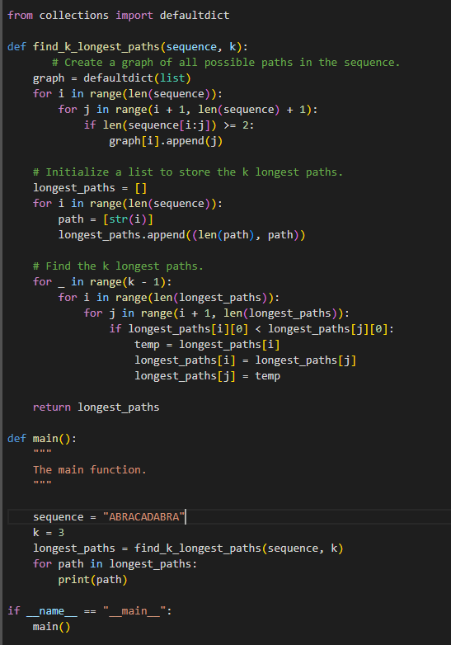
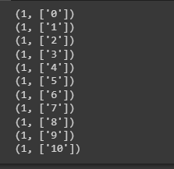

Slide 20


Ranking Candidate Peptides
We use the breadth first search method to generate all candidate peptides from the k longest paths. In this step, peptides whose precursor masses are outside the given tolerance range are eliminated.
For a candidate peptide, if the number of amino acids equals the number of edges in the corresponding path, then all of the fragmentation sites in the peptide have at least one peak as evidence.
$${GAP}_{PEP}=L_{pep}−L_{path}(1)$$
$L_{pep}$ is the number of amino acids in the peptide, and
$L_{path}$ is the number of edges in the path
If a peptide has a lower GAP, it is considered to be more reliable.

Slide 21
Materials and Results
MS/MS Data
Benchmark Data Sets
pNovo+ was evaluated using HCD and ETD spectral pairs obtained from two distinct data sets. The first data set, known as the Worm data set, comprised MS/MS data derived from a whole cell lysate of C. elegans. This data was generated using an LTQ-Orbitrap XL mass spectrometer equipped with ETD, employing a six-step Multidimensional Protein Identification Technology (MudPIT) process.
Benchmark data sets are standardized sets of data that are commonly used in the evaluation and comparison of algorithms, methods, or software tools. In the context of de novo peptide sequencing, benchmark data sets play a crucial role in assessing the performance and accuracy of different algorithms or tools.
Benchmark data sets typically consist of experimental data obtained from mass spectrometry (MS) experiments, including MS/MS spectra.
The second data set, referred to as the 8-protein STD data set, was partially described by Chi et al. In this case, four different enzymes (Asp-N, elastase, Glu-C, and trypsin) were employed during sample preparation, resulting in four distinct MS/MS data sets for each sample.
Benchmark data sets for de novo peptide sequencing may include the following characteristics:
Diversity
Experimental conditions
Annotations
Size
Across all experiments conducted, the MS resolution was set to 60000, while the MS/MS resolution was set to 7500.

Slide 22
Comparison between HCD + ETD and HCD or ETD Alone
Advantages of HCD or ETD alone:
Specific fragmentation modes: Using either HCD or ETD alone allows researchers to focus on a specific fragmentation mode. This can be advantageous when studying specific types of peptides or when prioritizing certain types of structural information.
Simplified data analysis: Analyzing data from a single fragmentation technique may be more straightforward and require less computational resources compared to integrating data from multiple techniques.
Disadvantages of HCD or ETD alone:
Reduced sequence coverage: Utilizing a single fragmentation method may result in lower sequence coverage, potentially missing important information for complete peptide identification.
Limited PTM characterization: Depending on the fragmentation method chosen, the ability to confidently identify and localize PTMs may be compromised, leading to a potential loss of valuable information.

Slide 23
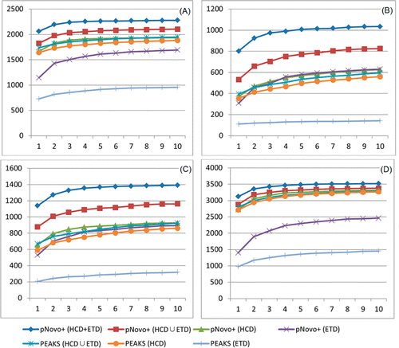
Cumulative curves of the number of correct sequences found among the top one to top 10 candidates obtained using
pNovo+ (HCD + ETD), pNovo+ (HCD ∪ ETD), pNovo+ (HCD),
pNovo+ (ETD),
PEAKS (HCD ∪ ETD), PEAKS (HCD),
PEAKS (ETD)
on the Worm data set. (A) Asp-N, (B) elastase, (C) Glu-C, and (D) trypsin.
pNovo+ (HCD + ETD) obtained the highest number of correct sequences in all four subdata sets (Asp-N, elastase, Glu-C, and tryptic peptides).

